Slide 1
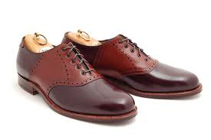
SHOE
A small demonstration that helps us
practice the skills of doing experiments
and making observations.
S - Summary Statement:
H – Hypothesis:
O – Observations:
E – Explanation:

Slide 2
S – Summary Statement:
A summary of what is going
to be demonstrated
Write a 1 to 2 sentence summary of what you are about to see.
A diagram may be included in this section.

Slide 3
H - Hypothesis:
What you think is going to happen
and why.
Explain what you think is going to happen
Explain why you think it is going to happen.
Note: The why is just as important as the what.

Slide 4
O – Observations:
Record appropriate qualitative and/or quantitative observations.
Qualitative Observations: What you can see and sense (e.g. colour, shape)
Quantitative Observations: What you can measure (e.g. length, mass)

Slide 5
E – Explanation:
Attempt to explain what happened during the experiment
  How well did your hypothesis explain what was observed?
  What needs to be changed to improve your hypothesis?
Note: An educated response is just as good as the right answer for SHOEs.

Slide 6
SHOE
S - Summary Statement:
A summary of what is going to be demonstrated
H – Hypothesis
What you think is going to happen and why. Note: The why is just as important as the what.
O – Observations:
Record appropriate qualitative and/or quantitative observations.
E – Explanation:
Attempt to explain what happened during the experiment and if it was in line with what you predicted in the hypothesis.

